Slide 1

Notes:
11/11/22

Slide 2

Chapter 18
Concurrency Control Techniques
Copyright © 2004 Pearson Education, Inc.
Notes:
11/11/22

Slide 3
Chapter 18 Outline
Databases Concurrency Control
1 Purpose of Concurrency Control
2 Two-Phase locking
5 Limitations of CCMs
6 Index Locking
7 Lock Compatibility Matrix
8 Lock Granularity
Chapter 18-<number>
Notes:
11/11/22

Slide 4
Database Concurrency Control
Purpose of Concurrency Control
  To enforce Isolation (through mutual exclusion) among conflicting transactions.
  To preserve database consistency through consistency preserving execution of transactions.
  To resolve read-write and write-write conflicts.
  Example: In concurrent execution environment if T₁ conflicts with T₂ over a data item A, then the existing concurrency control decides if T₁ or T₂ should get the data item A and if the other transaction is rolled-back or waits.
Chapter 18-<number>
Notes:
11/11/22

Slide 5
Database Concurrency Control
Two-Phase Locking Techniques
  Locking is an operation which secures (a) permission to Read or (b) permission to Write a data item for a transaction. Example: Lock (X). Data item X is locked in behalf of the requesting transaction.
  Unlocking is an operation which removes these permissions from the data item.
  Example: Unlock (X). Data item X is made available to all other transactions.
  Lock and Unlock are Atomic operations.
Chapter 18-<number>

Slide 6
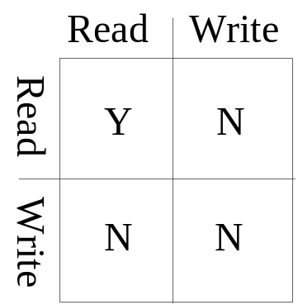
Database Concurrency Control
Two-Phase Locking Techniques: Essential components
Two locks modes (a) shared (read) and (b) exclusive (write).
  Shared mode: shared lock (X). More than one transaction can apply share lock on X for reading its value but no write lock can be applied on X by any other transaction.
  Exclusive mode: Write lock (X). Only one write lock on X can exist at any time and no shared lock can be applied by any other transaction on X.
  Conflict matrix
Chapter 18-<number>

Slide 7
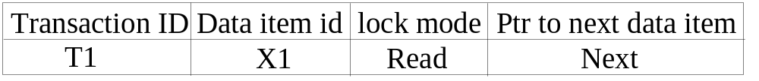
Database Concurrency Control
Two-Phase Locking Techniques: Essential components
  Lock Manager: Managing locks on data items.
  Lock table: Lock manager uses it to store the identity of transaction locking a data item, the data item, lock mode and pointer to the next data item locked. One simple way to implement a lock table is through linked list.
Chapter 18-<number>

Slide 8
Database Concurrency Control
Two-Phase Locking Techniques: Essential components
  Database requires that all transactions should be well-formed. A transaction is well-formed if:
It must lock the data item before it reads or writes to it.
It must not lock an already locked data item and it must not try to unlock a free data item.
Chapter 18-<number>

Slide 9
Database Concurrency Control
Binary Locks
A binary lock can have two states or values: locked and unlocked (or 1 and 0, for simplicity).
A distinct lock is associated with each database item X.
If the value of the lock on X is 1, item X cannot be accessed by a database operation that requests the item.
If the value of the lock on X is 0, the item can be accessed when requested, and the lock value is changed to 1.
A binary lock enforces mutual exclusion on the data item.
The lock_item and unlock_item operations must be atomic.
Chapter 18-<number>

Slide 10
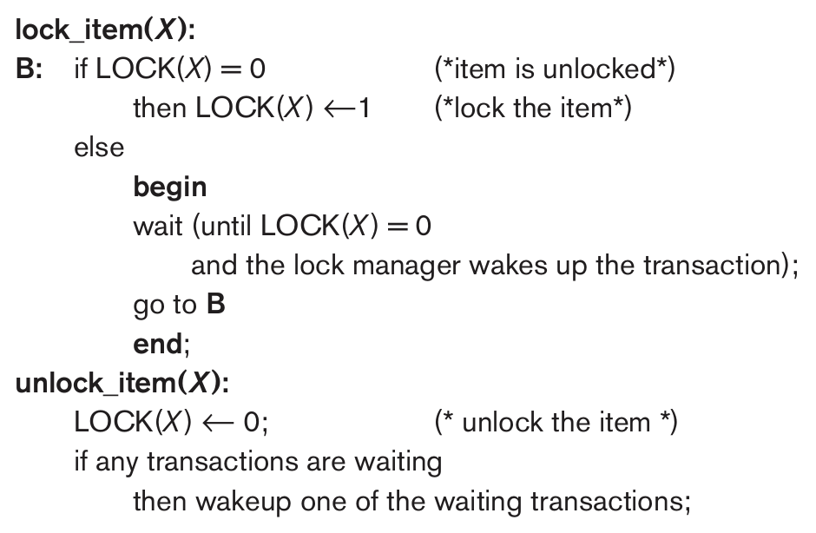
Database Concurrency Control
Lock and unlock operations for binary locks
Chapter 18-<number>

Slide 11
Database Concurrency Control
Rules for binary locks
  A transaction T must issue the operation lock_item(X) before any read_item(X) or write_item(X) operations are performed in T.
  A transaction T must issue the operation unlock_item(X) after all read_item(X) and write_item(X) operations are completed in T.
  A transaction T will not issue a lock_item(X) operation if it already holds the lock on item X.
  A transaction T will not issue an unlock_item(X) operation unless it already holds the lock on item X.
Note: Binary locks are simple but are also too restrictive for database concurrency control purposes and so are not used much.
Chapter 18-<number>

Slide 12
Database Concurrency Control
Shared/Exclusive (or Read/Write) Locks
  Binary locking scheme is too restrictive for database items because at most one transaction can hold a lock on a given item.
  We should allow several transactions to access the same item X if they all access X for reading purposes only -- because read operations on the same item by different transactions are not conflicting.
  In this scheme a multiple mode lock called shared/exclusive or read/write locks with three locking operations: read_lock (X), write_lock (X), and unlock (X) are used.
Chapter 18-<number>

Slide 13
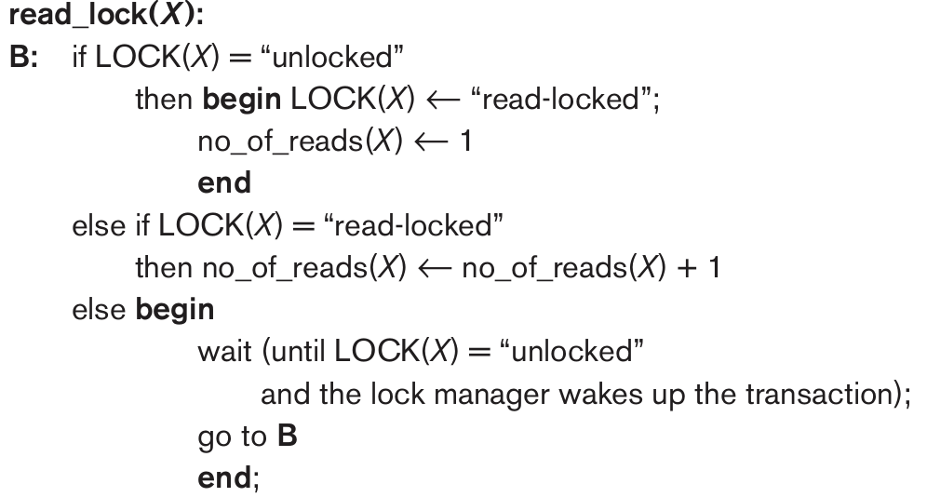
Database Concurrency Control
Shared/Exclusive (or Read/Write) Locks: read_lock(X)
Chapter 18-<number>

Slide 14
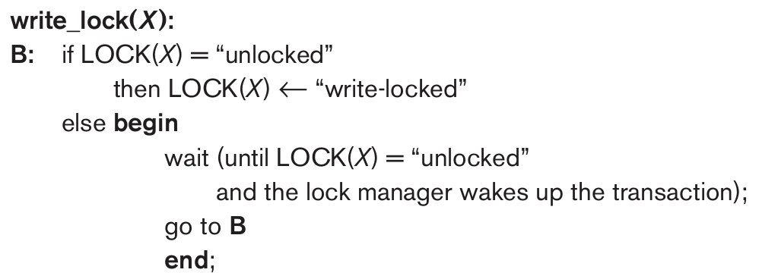
Database Concurrency Control
Shared/Exclusive (or Read/Write) Locks:write_lock(X)
Chapter 18-<number>

Slide 15
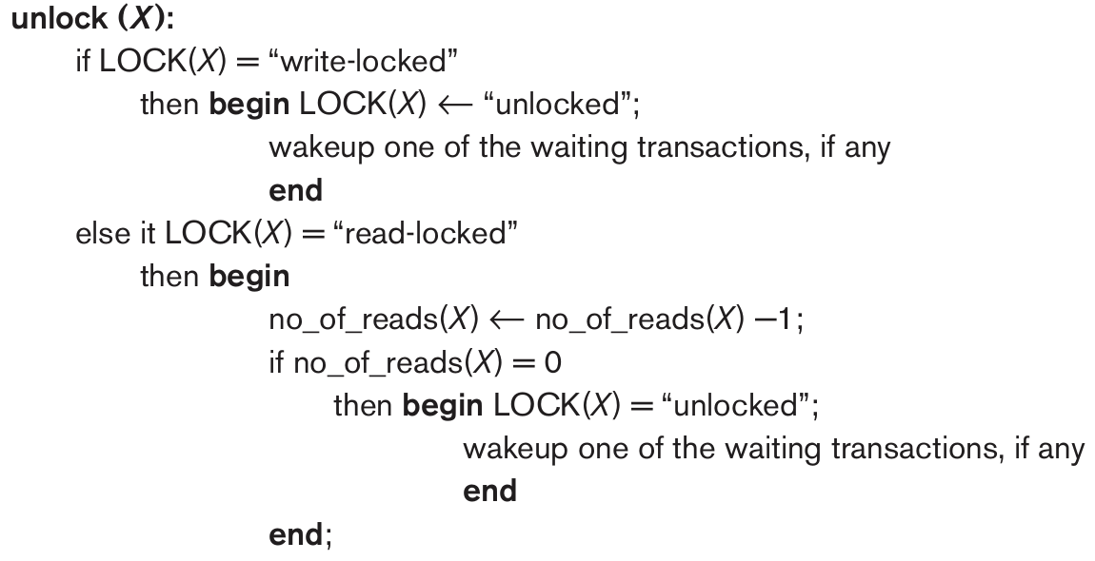
Database Concurrency Control
Shared/Exclusive (or Read/Write) Locks:unlock(X)
Chapter 18-<number>

Slide 16
Database Concurrency Control
Shared/Exclusive (or Read/Write) Locks: Rules
  A transaction T must issue the operation read_lock(X) or write_lock(X) before any read_item (X) operation is performed in T.
  A transaction T must issue the operation write_lock(X) before any write_item(X) operation is performed in T.
  A transaction T must issue the operation unlock(X) after all read_item(X) and write_item(X) operations are completed in T.
  A transaction T will not issue a read_lock(X) operation if it already holds a read (shared) lock or a write (exclusive) lock on item X. This rule may be relaxed for downgrading of locks.
  A transaction T will not issue a write_lock (X) operation if it already holds a read (shared) lock or write (exclusive) lock on item X. This rule may also be relaxed for upgrading of locks.
  A transaction T will not issue an unlock (X) operation unless it already holds a read (shared) lock or a write (exclusive) lock on item X.
Chapter 18-<number>

Slide 17
Database Concurrency Control
Lock conversion
Lock upgrade: existing read lock to write lock
if T_{i} has a read-lock (X) and T_{j} has no read-lock (X) (i ≠ j) then
  convert read-lock (X) to write-lock (X)
  else
  force T_{i} to wait until T_{j} unlocks X
  Lock downgrade: existing write lock to read lock
Ti has a write-lock (X) (*no transaction can have any lock on X*)
  convert write-lock (X) to read-lock (X)
Chapter 18-<number>

Slide 18
Database Concurrency Control
Two-Phase Locking Techniques: The algorithm
A transaction is said to follow the two-phase locking protocol if all locking operations (read_lock, write_lock) precede the first unlock operation in the transaction.
Two Phases: (a) Locking (Growing) (b) Unlocking (Shrinking).
Locking (Growing) Phase: A transaction applies locks (read or write) on desired data items one at a time.
Unlocking (Shrinking) Phase: A transaction unlocks its locked data items one at a time.
Requirement: For a transaction, these two phases must be mutually exclusive, i.e., during locking phase, unlocking phase must not start and during unlocking phase locking phase must not begin.
Chapter 18-<number>

Slide 19
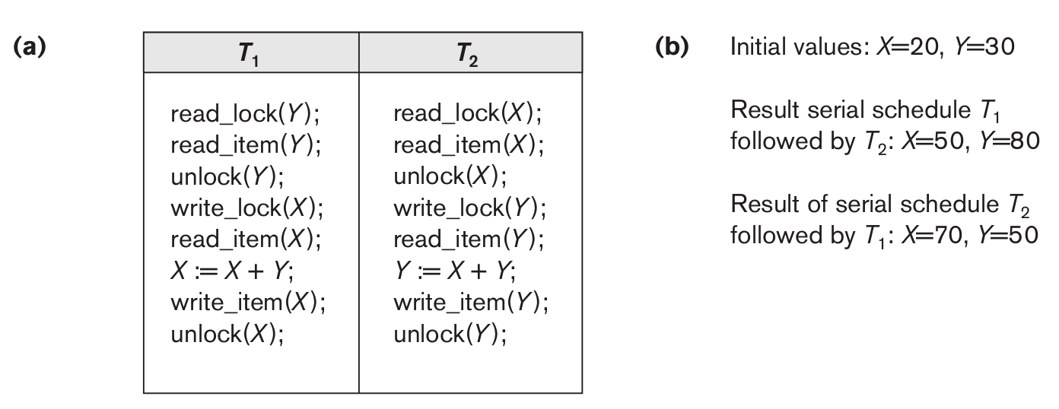
Database Concurrency Control
Two-Phase Locking Techniques: The algorithm
Using binary locks or read/write locks in transactions, as described earlier, does not guarantee serializability of schedules. Items Y in T₁ and X in T₂ were unlocked too early.
Transactions T₁ and T₂ above do not follow the two-phase locking protocol because the write_lock(X) operation follows the unlock(Y) operation in T₁ , similarly the write_lock (Y) operation follows the unlock(X) operation in T₂.
Chapter 18-<number>

Slide 20
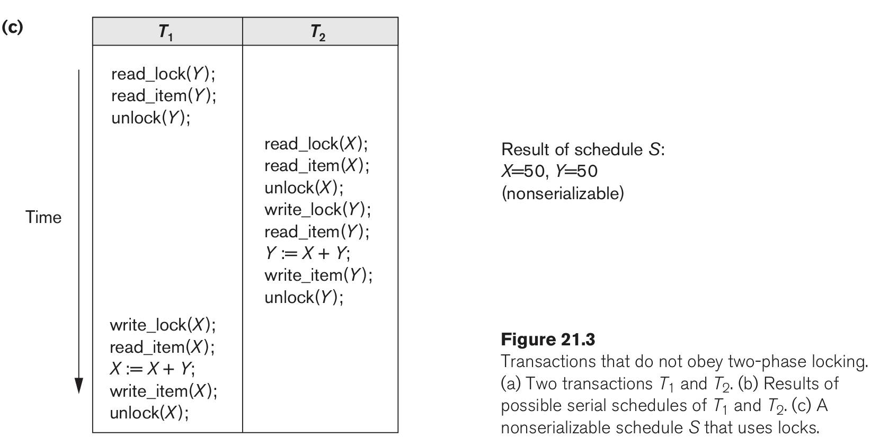
Database Concurrency Control
Two-Phase Locking Techniques: The algorithm
Using binary locks or read/write locks in transactions, as described earlier, does not guarantee serializability of schedules.
Chapter 18-<number>

Slide 21
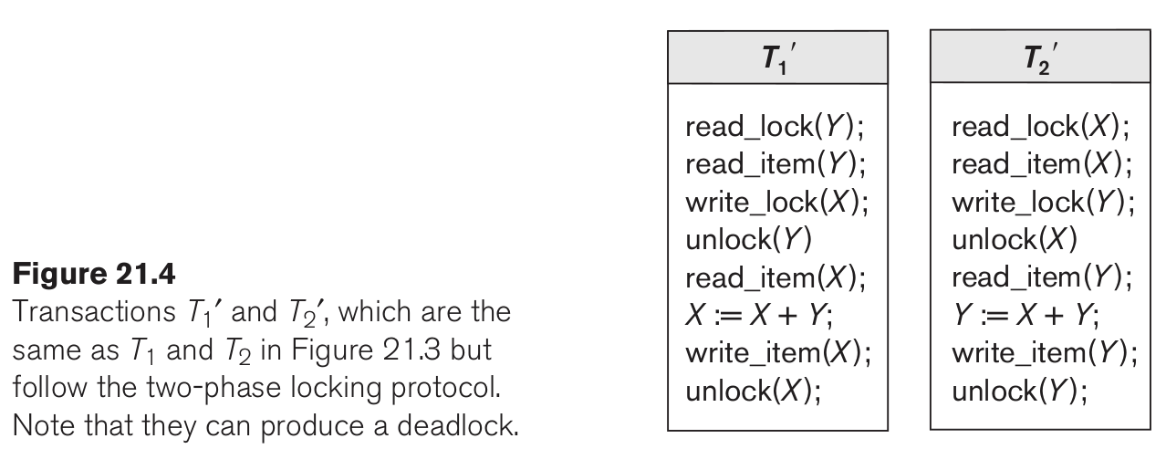
Database Concurrency Control
Two-Phase Locking Techniques: The algorithm
Enforcing two-phase locking:
Chapter 18-<number>

Slide 22
Database Concurrency Control
Two-Phase Locking Techniques: The algorithm
If every transaction in a schedule follows the two-phase locking protocol, the schedule is guaranteed to be serializable, obviating the need to test for serializability of schedules.
The locking protocol, by enforcing two-phase locking rules, also enforces serializability.
Two-phase locking may limit the amount of concurrency that can occur in a schedule because a transaction T may not be able to release an item X after it is through using it if T must lock an additional item Y later; or, conversely, T must lock the additional item Y before it needs it so that it can release X. Hence, X must remain locked by T
Chapter 18-<number>

Slide 23
Database Concurrency Control
Two-Phase Locking Techniques: The algorithm
Two-phase policy generates four locking algorithms Basic, Conservative, Strict, and Rigorous.
        Conservative: Prevents deadlock by locking all desired data items before transaction begins execution.
        Basic: Transaction locks data items incrementally. This may cause deadlock which is dealt with.
        Strict: A more stricter version of Basic algorithm where a transaction T does not release any of its exclusive (write) locks until after it commits or aborts.
        Rigorous: a transaction T does not release any of its locks (exclusive or shared) until after it commits or aborts.
Chapter 18-<number>

Slide 24
Database Concurrency Control
Dealing with Deadlock and Starvation
Deadlock prevention
A transaction locks all data items it refers to before it begins execution. This way of locking prevents deadlock since a transaction never waits for a data item. The conservative two-phase locking uses this approach.
Chapter 18-<number>

Slide 25
Database Concurrency Control
Dealing with Deadlock and Starvation
Deadlock detection and resolution
In this approach, deadlocks are allowed to happen. The scheduler maintains a wait-for-graph for detecting cycle. If a cycle exists, then one transaction involved in the cycle is selected (victim) and rolled-back.
A wait-for-graph is created using the lock table. As soon as a transaction is blocked, it is added to the graph. When a chain like: T_{i} waits for T_{j}, T_{j} waits for T_{k}, T_{k} waits for T_{i} or T_{j} occurs, then this creates a cycle. One of the transaction of the cycle is selected and rolled back.
Chapter 18-<number>

Slide 26
Database Concurrency Control
Dealing with Deadlock and Starvation
Deadlock avoidance
There are many variations of two-phase locking algorithm. Some avoid deadlock by not letting the cycle to complete. That is as soon as the algorithm discovers that blocking a transaction is likely to create a cycle, it rolls back the transaction. Wound-Wait and Wait-Die algorithms use timestamps to avoid deadlocks by rolling-back victim.
Chapter 18-<number>

Slide 27
Database Concurrency Control
Dealing with Deadlock and Starvation
Starvation
Starvation occurs when a particular transaction consistently waits or restarted and never gets a chance to proceed further. In a deadlock resolution it is possible that the same transaction may consistently be selected as victim and rolled-back. This limitation is inherent in all priority based scheduling mechanisms. In Wound-Wait scheme a younger transaction may always be wounded (aborted) by a long running older transaction which may create starvation.
Chapter 18-<number>

Slide 28
Database Concurrency Control
Timestamp based concurrency control algorithm
Timestamp
transaction timestamp TS (T′), is a unique identifier assigned to each transaction.
It is a monotonically increasing variable (integer) indicating the age of an operation or a transaction. A larger timestamp value indicates a more recent event or operation.
Timestamp based algorithm uses timestamp to serialize the execution of concurrent transactions.
The timestamps are typically based on the order in which transactions are started; hence, if transaction T₁ starts before transaction T₂ , then TS(T₁ ) < TS (T₂). Notice that the older transaction (which starts first) has the smaller timestamp value.
Chapter 18-<number>

Slide 29
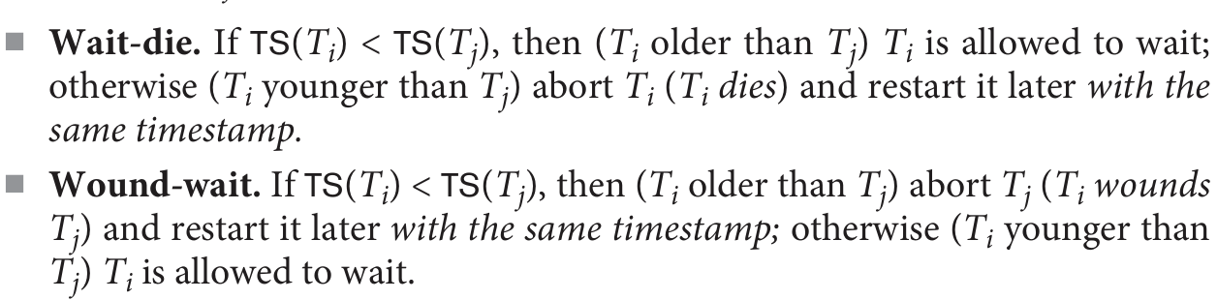
Database Concurrency Control
Timestamp: deadlock are called wait-die and wound-wait
Chapter 18-<number>

Slide 30
Database Concurrency Control
Timestamp based concurrency control algorithm
Basic Timestamp Ordering
1. Transaction T issues a write_item(X) operation:
    If read_TS(X) > TS(T) or if write_TS(X) > TS(T), then an younger transaction has already read the data item so abort and roll-back T and reject the operation.
    If the condition in part (a) does not exist, then execute write_item(X) of T and set write_TS(X) to TS(T).
  2. Transaction T issues a read_item(X) operation:
    If write_TS(X) > TS(T), then an younger transaction has already written to the data item so abort and roll-back T and reject the operation.
    If write_TS(X) ≤ TS(T), then execute read_item(X) of T and set read_TS(X) to the larger of TS(T) and the current read_TS(X).
Chapter 18-<number>

Slide 31
Database Concurrency Control
Timestamp based concurrency control algorithm
Strict Timestamp Ordering
1. Transaction T issues a write_item(X) operation:
    If TS(T) > read_TS(X), then delay T until the transaction T’ that wrote or read X has terminated (committed or aborted).
  2. Transaction T issues a read_item(X) operation:
    If TS(T) > write_TS(X), then delay T until the transaction T’ that wrote or read X has terminated (committed or aborted).
Chapter 18-<number>

Slide 32
Database Concurrency Control
Timestamp based concurrency control algorithm
Thomas’s Write Rule
  If read_TS(X) > TS(T) then abort and roll-back T and reject the operation.
  If write_TS(X) > TS(T), then just ignore the write operation and continue execution. This is because the most recent writes counts in case of two consecutive writes.
  If the conditions given in 1 and 2 above do not occur, then execute write_item(X) of T and set write_TS(X) to TS(T).
Chapter 18-<number>

Slide 33
Database Concurrency Control
Multiversion concurrency control techniques
Concept
This approach maintains a number of versions of a data item and allocates the right version to a read operation of a transaction. Thus unlike other mechanisms a read operation in this mechanism is never rejected.
Side effect: Significantly more storage (RAM and disk) is required to maintain multiple versions. To check unlimited growth of versions, a garbage collection is run when some criteria is satisfied.
Chapter 18-<number>

Slide 34
Database Concurrency Control
Multiversion technique based on timestamp ordering
This approach maintains a number of versions of a data item and allocates the right version to a read operation of a transaction. Thus unlike other mechanisms a read operation in this mechanism is never rejected.
Side effects: Significantly more storage (RAM and disk) is required to maintain multiple versions. To check unlimited growth of versions, a garbage collection is run when some criteria is satisfied.
Chapter 18-<number>

Slide 35
Database Concurrency Control
Multiversion technique based on timestamp ordering
Assume X1, X2, …, Xn are the version of a data item X created by a write operation of transactions. With each Xi a read_TS (read timestamp) and a write_TS (write timestamp) are associated.
read_TS(Xi): The read timestamp of Xi is the largest of all the timestamps of transactions that have successfully read version Xi.
write_TS(Xi): The write timestamp of Xi that wrote the value of version Xi.
A new version of Xi is created only by a write operation.
Chapter 18-<number>

Slide 36
Database Concurrency Control
Multiversion technique based on timestamp ordering
To ensure serializability, the following two rules are used.
If transaction T issues write_item (X) and version i of X has the highest write_TS(Xi) of all versions of X that is also less than or equal to TS(T), and read _TS(Xi) > TS(T), then abort and roll-back T; otherwise create a new version Xi and read_TS(X) = write_TS(Xj) = TS(T).
If transaction T issues read_item (X), find the version i of X that has the highest write_TS(Xi) of all versions of X that is also less than or equal to TS(T), then return the value of Xi to T, and set the value of read _TS(Xi) to the largest of TS(T) and the current read_TS(Xi).
Chapter 18-<number>

Slide 37
Database Concurrency Control
Multiversion technique based on timestamp ordering
To ensure serializability, the following two rules are used.
If transaction T issues write_item (X) and version i of X has the highest write_TS(Xi) of all versions of X that is also less than or equal to TS(T), and read _TS(Xi) > TS(T), then abort and roll-back T; otherwise create a new version Xi and read_TS(X) = write_TS(Xj) = TS(T).
If transaction T issues read_item (X), find the version i of X that has the highest write_TS(Xi) of all versions of X that is also less than or equal to TS(T), then return the value of Xi to T, and set the value of read _TS(Xi) to the largest of TS(T) and the current read_TS(Xi).
Rule 2 guarantees that a read will never be rejected.
Chapter 18-<number>

Slide 38
Database Concurrency Control
Multiversion Two-Phase Locking Using Certify Locks
Concept
Allow a transaction T’ to read a data item X while it is write locked by a conflicting transaction T.
This is accomplished by maintaining two versions of each data item X where one version must always have been written by some committed transaction. This means a write operation always creates a new version of X.
Chapter 18-<number>

Slide 39
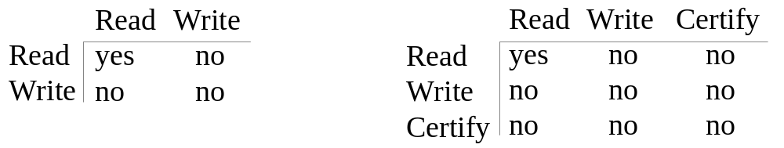
Database Concurrency Control
Multiversion Two-Phase Locking Using Certify Locks
Steps
  X is the committed version of a data item.
  T creates a second version X’ after obtaining a write lock on X.
  Other transactions continue to read X.
  T is ready to commit so it obtains a certify lock on X’.
  The committed version X becomes X’.
  T releases its certify lock on X’, which is X now.
Compatibility tables for
read/write locking scheme read/write/certify locking scheme
Chapter 18-<number>

Slide 40
Database Concurrency Control
Multiversion Two-Phase Locking Using Certify Locks
Note
In multiversion 2PL read and write operations from conflicting transactions can be processed concurrently. This improves concurrency but it may delay transaction commit because of obtaining certify locks on all its writes. It avoids cascading abort but like strict two phase locking scheme conflicting transactions may get deadlocked.
Chapter 18-<number>

Slide 41
Database Concurrency Control
Validation (Optimistic) Concurrency Control Schemes
In this technique only at the time of commit serializability is checked and transactions are aborted in case of non-serializable schedules.
Three phases:
Read phase: A transaction can read values of committed data items. However, updates are applied only to local copies (versions) of the data items (in database cache).
Chapter 18-<number>

Slide 42
Database Concurrency Control
Validation (Optimistic) Concurrency Control Schemes
Validation phase: Serializability is checked before transactions write their updates to the database.
  This phase for Ti checks that, for each transaction Tj that is either committed or is in its validation phase, one of the following conditions holds:
    Tj completes its write phase before Ti starts its read phase.
    Ti starts its write phase after Tj completes its write phase, and the read_set of Ti has no items in common with the write_set of Tj
    Both the read_set and write_set of Ti have no items in common with the write_set of Tj, and Tj completes its ead phase.
Chapter 18-<number>

Slide 43
Database Concurrency Control
Validation (Optimistic) Concurrency Control Schemes
When validating Ti, the first condition is checked first for each transaction Tj, since (1) is the simplest condition to check. If (1) is false then (2) is checked and if (2) is false then (3 ) is checked. If none of these conditions holds, the validation fails and Ti is aborted.
Write phase: On a successful validation transactions’ updates are applied to the database; otherwise, transactions are restarted.
Chapter 18-<number>

Slide 44
Database Concurrency Control
Granularity of data items and Multiple Granularity Locking
A lockable unit of data defines its granularity. Granularity can be coarse (entire database) or it can be fine (a tuple or an attribute of a relation). Data item granularity significantly affects concurrency control performance. Thus, the degree of concurrency is low for coarse granularity and high for fine granularity. Example of data item granularity:
  A field of a database record (an attribute of a tuple).
  A database record (a tuple or a relation).
  A disk block.
  An entire file.
  The entire atabase.
Chapter 18-<number>

Slide 45
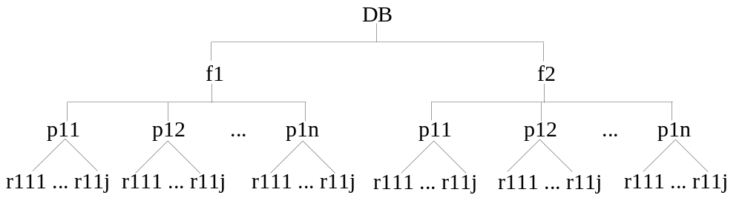
Database Concurrency Control
Granularity of data items and Multiple Granularity Locking
The following diagram illustrates a hierarchy of granularity from coarse (database) to fine (record).
Chapter 18-<number>

Slide 46
Database Concurrency Control
Granularity of data items and Multiple Granularity Locking
To manage such hierarchy, in addition to read and write, three additional locking modes, called intention lock modes are defined:
Intention-shared (IS): indicates that a shared lock(s) will be requested on some descendent nodes(s).
Intention-exclusive (IX): indicates that an exclusive lock(s) will be requested on some descendent nodes(s).
Shared-intention-exclusive (SIX): indicates that the current node is locked in shared mode but an exclusive lock(s) will be requested on some descendent nodes(s).
Chapter 18-<number>

Slide 47
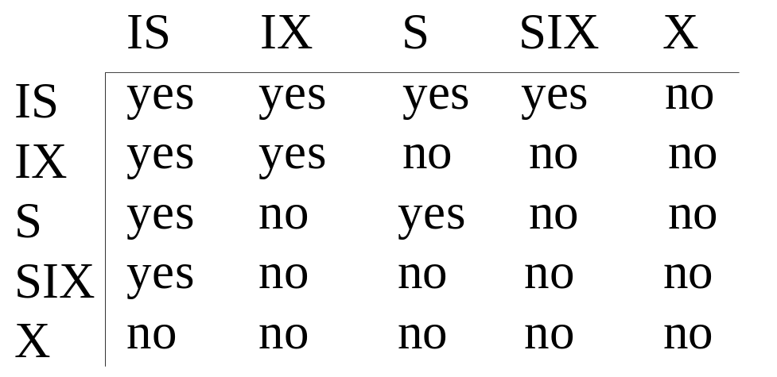
Database Concurrency Control
Granularity of data items and Multiple Granularity Locking
These locks are applied using the following compatibility matrix:
Chapter 18-<number>

Slide 48
Database Concurrency Control
Granularity of data items and Multiple Granularity Locking
The set of rules which must be followed for producing serializable schedule are
    The lock compatibility must adhered to.
    The root of the tree must be locked first, in any mode..
    A node N can be locked by a transaction T in S or IX mode only if the parent node is already locked by T in either IS or IX mode.
    A node N can be locked by T in X, IX, or SIX mode only if the parent of N is already locked by T in either IX or SIX mode.
    T can lock a node only if it has not unlocked any node (to enforce 2PL policy).
    T can unlock a node, N, only if none of the children of N are currently locked by T.
Chapter 18-<number>

Slide 49
Database Concurrency Control
Granularity of data items and Multiple Granularity Locking
An example of a serializable execution:
T1 T2 T3
IX(db)
IX(f1)
IX(db)
IS(db)
IS(f1)
IS(p11)
IX(p11)
X(r111)
IX(f1)
X(p12)
S(r11j)
IX(f2)
IX(p21)
IX(r211)
Unlock (r211)
Unlock (p21)
Unlock (f2)
S(f2)
Chapter 18-<number>

Slide 50
Database Concurrency Control
Granularity of data items and Multiple Granularity Locking
An example of a serializable execution (continued):
T1 T2 T3
unlock(p12)
unlock(f1)
unlock(db)
unlock(r111)
unlock(p11)
unlock(f1)
unlock(db)
unlock (r111j)
unlock (p11)
unlock (f1)
unlock(f2)
unlock(db)
Chapter 18-<number>

